Slide 1
Welcome
CSE 3902
1

Slide 2
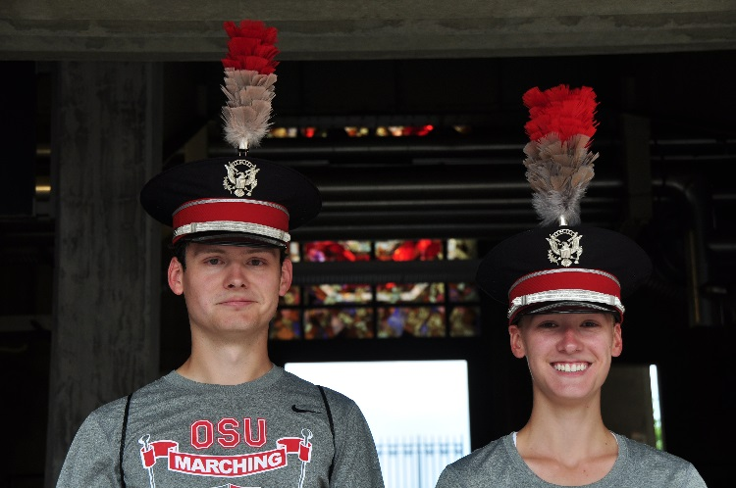
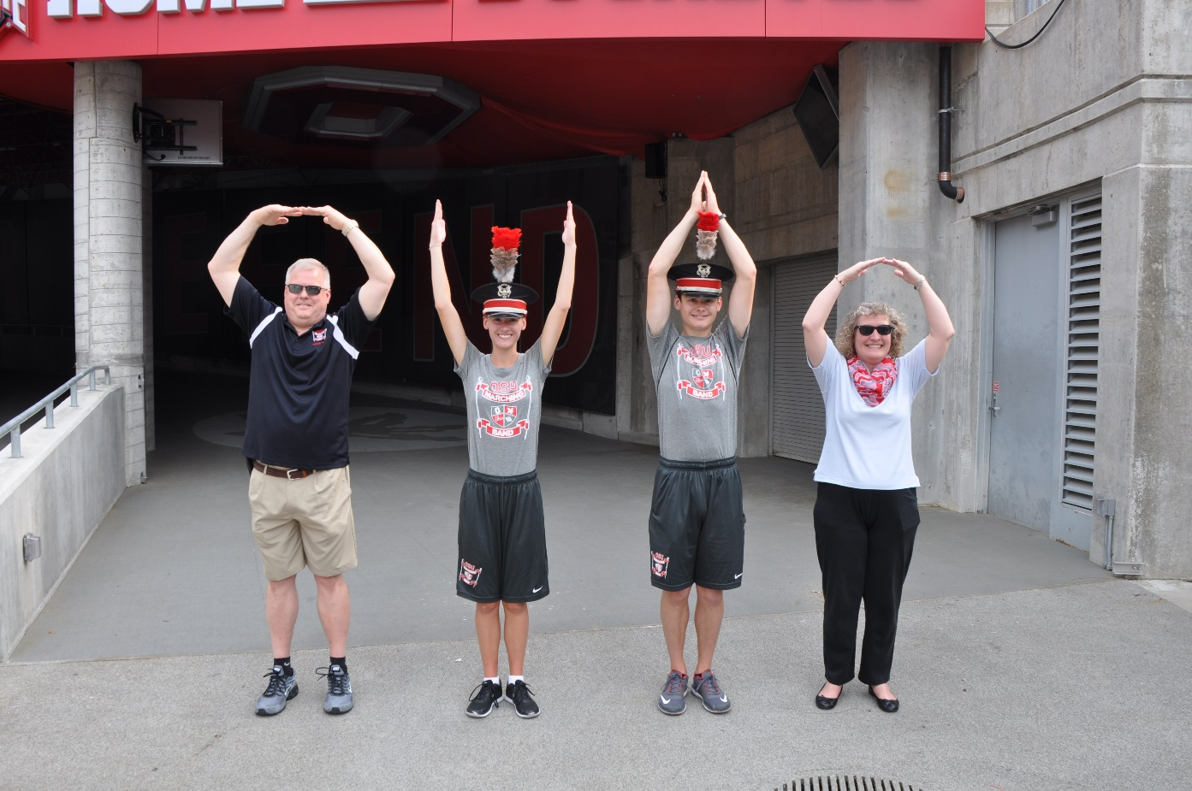
Scott Mills mills.680@osu.edu
2

Slide 3
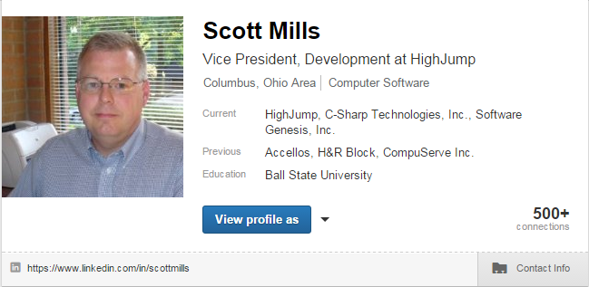
About me:
Linda Mills: Cardinal Health Human Resources
Brandon Mills: Drive Capital Software Engineer
Abigail Mills: Junior - The Ohio State University
33 years in the Software Industry

Slide 4
About you?
Name
  As on Roster
  As you prefer
Year in School
Relevant to CSE Internship or Employment
  When, Where and What you did
What you’re hoping to “learn” in CSE3902
Fun Fact about you not many know

Slide 5
3902 Syllabus
Course Summary
This is a course on professional software development. Our goals are to craft high-quality software, understand the process of Agile software development, survey design patterns, become familiar with advanced tools for software development and project management, and experience working in a small sized team (4-5 people).
To facilitate reaching these goals, you will work on developing and refining an engine for 2D platformer games over the course of the semester. There will be a large amount of critiquing of code and interactive feedback. This will lead to refinement and improvement of your software (for future expansion and maintenance).

Slide 6
3902 Syllabus
Workload Expectations
Workload expectations are an estimate of the amount of work needed for an average student to earn an average grade. Course grades are based on the quality of the work submitted, not on hours of effort.
One credit represents, for the average Ohio State University undergraduate student, three hours of academic work per week (including lectures, laboratories, recitations, discussion groups, field work, study, and so on), averaged over the semester, in order to complete the work of the course to achieve an average grade. 1 credit x 3 hours of work per week equals 3 hours of academic work to achieve an average grade. Thus, enrollment in a 4 credit course represents approximately 12 hours of work per week, on average, over the course of the semester to earn an average grade.

Slide 7
CSE 3902 Web Site
URL
http://www.c-sharp.com/CSE3902/AU17/index.html

Slide 8
?

